Slide 1

SRM INSTITUTE OF SCIENCE AND TECHNOLOGY
COLLEGE OF ENGINEERING AND TECHNOLOGY
DEPARTMENT OF NETWORKING AND COMMUNICATIONS
18CSP111L MAJOR PROJECT
SMS Spam Detection using Natural Language Processing and Ensemble Learning
Student 1 Reg No : Aditya Kumar RA1911030010100
Student 2 Reg No : Adarsh Mahapatra RA1911030010071
Batch ID: NW064
Guide name and Designation : Dr. C. Fancy
Assistant Professor

Slide 2
Table of Contents
Abstract
Introduction
Motivation
Literature Survey
Challenges and limitations in existing system
Objectives of the project
Innovation Idea
Scope and application of the project
Proposed Architecture
Proposed Modules
Results
Future Improvements
Conclusion
References
Publication Status

Slide 3
Abstract
SMS Spam is sent by scammers trying to phish on people where they send a message to the victim saying that they have won something and want the victim to click on a malicious link to steal data or access the victim’s device. By creating multiple models for spam detection and combining the best performing models using ensemble learning techniques would give us a model which would predict a text message from spam and legitimate with much more accuracy. The model will be integrated into image steganography tool to hide message and keep it more secure in transit.

Slide 4
Introduction
Ensemble learning is a type of learning in AI/ML where multiple different models are used and then their different outputs are combined to give a final result.
By using the concept of ensemble learning, we can train multiple models and choose the ones with very high accuracy and precision and use those models together to get a model which gives a more accurate prediction.
As SMS has turned into MMS nowadays, sending images with hidden text using steganography can be used to provide another layer of security in text messages.

Slide 5
Motivation
To provide security in SMS messages by detecting spam messages and add another layer to it by implementation of Image Steganography to hide text while texting sensitive data.
Provide a proof of concept so that implementation of this project can be done in proprietary messaging services in Android and Mac and private messaging applications.

Slide 6
Literature Survey
S. No. | Name of Paper | Author and Publication year | Inferences | Limitations
1 | A constant time complexity spam detection algorithm for boosting throughput on rule-based filtering systems | Xia, T. (2020). | Rule based filtering was the first technique used in spam detection. The rules were typically based on specific keywords, phrases, or patterns.The text was parsed through regex of rules to determine it as spam or not. | As used of words and slangs change overtime, it is not feasible to use the same rules, more would be needed which would not be efficient

Slide 7
Literature Survey
S. No. | Name of Paper | Author and Publication year | Inferences | Limitations
2 | Deep learning to filter SMS Spam | Roy, P. K., Singh, J. P., & Banerjee, S. (2020). | Context based filtering was the next technique used for spam detection. It takes into account the context in which a message is received and analyze to determine its likelihood of being spam. This approach considers a range of factors beyond just the content of the message itself, such as the sender’s reputation, the content of previous messages from the same sender, and the behavior of the recipient in responding to similar messages. | The filtering method could be easily spoofed by attackers by performing SS7 network attacks and impersonation the sender name and number as it only works on client side.

Slide 8
Literature Survey
S. No. | Name of Paper | Author and Publication year | Inferences | Limitations
3 | Spam detection in SMS based on feature selection Techniques. | Sharaff, A. (2019). | Feature selection technique was based on context based filtering, it built upon by adding features such as occurrences of specific words, rate of specific words in the test message and so on. | Feature extraction techniques often focus on capturing surface-level characteristics of spam messages, such as keywords or patterns. They may not fully capture the semantic meaning of the content, which can limit the detection accuracy.

Slide 9
Literature Survey
S. No. | Name of Paper | Author and Publication year | Inferences | Limitations
4 | Hybrid SMS spam filtering system using machine learning techniques | Baaqeel, H., & Zagrouba, R. (2020) | These were combinations of rule based filters and machine learning algorithms such as NB and SVM. The rule-based filter may be used to quickly and accurately identify messages that match certain predefined criteria, such as messages containing specific keywords.The machine learning algorithm was used to classify the remaining messages based on their content and other features. | Integrating multiple algorithms or methods requires careful coordination and synchronization, leading to increased complexity. If one component performs poorly or has limitations, it can impact the overall performance of the hybrid system.

Slide 10
Literature Survey
S. No. | Name of Paper | Author and Publication year | Inferences | Limitations
5 | An efficient steganographic technique for hiding data | Nashat, D., & Mamdouh, L. (2019). | Using LSB technique is more efficient where the dimension of the cover image is not restricted as other techniques would hide text on specific parts of the image that could corrupt the original message due to compression while in transit. | This technique is a common technique and can be cracked if the attacker figures out the technique used for hiding the text.

Slide 11
Challenges and Limitations
While combining the multiple models, we will need to choose the ones such that the accuracy does not decrease with keeping the precision of the model as high as possible as well. And even after creating the model, the model would still need constant training on new dataset including data generated and classified by the user themselves. Even after creating the model, it has been done so many times that attackers come up with newer phishing techniques. To prevent this, we implement an image steganography tool which can help double the security of the message while in transit.

Slide 12
Objectives of the project
The main goal of this project is to create an ensemble model with higher accuracy than its base models without losing precision of the model. Using the models that give 100% precision, we would take them as base models such that the final model can classify text messages as accurately as it can while avoiding false negatives. SMS apps can be modified such that instead of sending encrypted text messages, they send text messages hidden in images. The app would hide the text message in the image while transmitting it and will de decoded when received, even if an attacker figures it out the spam detector model will catch the message.

Slide 13
Innovation
The SMS spam detection models that have been previously created have not been created using ensemble learning techniques, i.e. current models have only been used creating Naive Bayes algorithm. By using AI model for spam detection and coupling it with image steganography to send modern sms messages so that they are harder to decrypt. Even if they are implemented in applications, they are only detecting spam and not preventing it. By creating an image steganography tool with the AI model, the text message will be hidden in an image, also providing security over the already encrypted text channel.

Slide 14
Scope and Application
The dataset will be preprocessed and features will be extracted such as number of words, letters and sentences. The words of texts will be stemmed and removing the stopwords after which the dataset will be trained on different Naive Bayes variants and the best performing model will be selected as the base models and other models including Random Forest, K nearest neighbors and more will be tested and the best performing models will be selected for the ensemble model.
The Image Steganography tool will be implemented with the custom model created and will be able to detect if the incoming message is spam or legitimate while decrypting it.

Slide 15
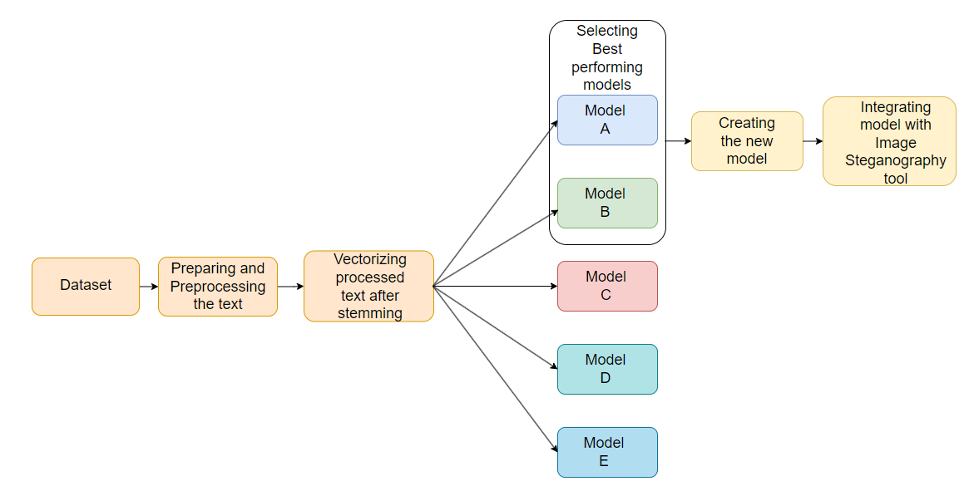
Proposed Architecture

Slide 16
Proposed modules
Data Preprocessing
The dataset will be preprocessed by removing duplicate fields and will be tokenized using nltk library. Special characters and stopwords will be removed from the tokenized data and the remaining words will be stemmed using PorterStemmer from nltk library.
Feature Extraction
Using nltk, features from the dataset such as Count of number of Characters, Words and Sentences will be extracted and will be used for creating the algorithmic models

Slide 17
Proposed modules
Model Building
The processed text will be vectorized using TF-IDF and scaled between 0 and 1 using MinMaxScaler. From sklearn library, the algorithms will be used to build the models and they will be compare based on their accuracy and precision. The models with high accuracy and precision will then be combined using Ensemble Learning Techniques to create a custom model. This model will serve as the spam detection model in this project.

Slide 18
Proposed modules
Image Steganography Tool
PIL and stego library from Python ,the PIL library will enable working with images in the project while the stego library will be used to implement 1-bit Least Significant Bit algorithm for hiding the text. The tool will have the capability to open a folder and select an image for cover image, and to hide text and another option “show” to decrypt the hidden text. The custom spam detection model will then be implemented with the decryption function of the tool and the text will be processed through the custom model to detect the text for spam.

Slide 19
Results
The best performing algorithmic models were found to be K Nearest Neighbours, Naive Bayes and Random Forest.
Model | Accuracy | Precision
KNN | 90.60% | 100%
NB | 97.38% | 98.23%
RF | 96.89% | 100%

Slide 20
Results
Stacking technique was used to combine these models with NB as base model and custom model KNR was obtained which has 97.48% accuracy and 94.26%. There was 0.1% increase in accuracy and while the precision was not 100%, higher accuracy was preferred over high precision. KNR model was then successfully implemented with the Image Steganography tool.

Slide 21
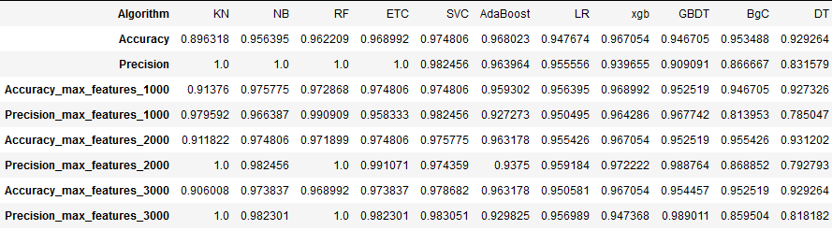
Results

Slide 22
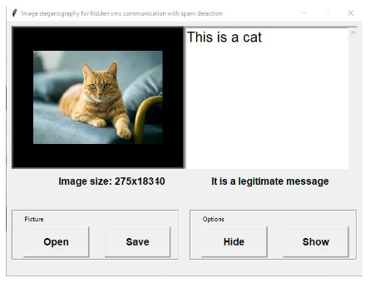
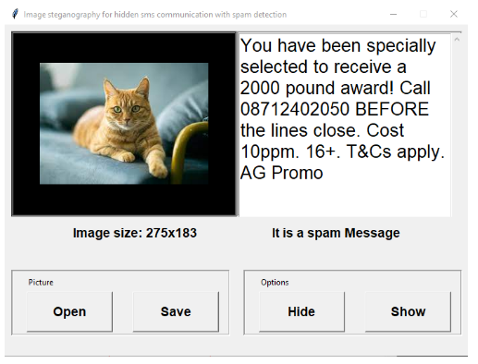
Results
Example of message detected Example of message detected
as legitimate as spam

Slide 23
Future Enhancements
Reinforced learning technique can be use to take feedback from the user to judge if the spam detection model labelled the text message correctly or not.
While the dimension of the image selected image will need to be limited, Spread Spectrum and Phase Encoding can be used instead of LSB but would need to tackle data corruption due to image compression while in transit.
This technology could be integrated with popular sms services such as Google and Apple Messages but the detection model would require multiple GB’s worth of datasets if it were to be implemented with such a big application

Slide 24
Conclusion
In this project, we created and compared several algorithms for Spam Detection and created a custom model KNR from the best performing models.
The Image Steganography tool using 1 bit LSB technique showed no hidden data corruption when dimensions of cover image were undefined.
The implementation of KNR model with Steganography tool was successful and the objective of this project were achieved.
We believe this study can contribute to further security improvement techniques in the field of messaging and provide as a good comparison between algorithmic models for sms spam detection.

Slide 25
References
[1] Xia, T. (2020). A constant time complexity spam detection algorithm for boosting throughput on rule-based filtering systems. IEEE Access, 8, 82653-82661.
[2] Roy, P. K., Singh, J. P., & Banerjee, S. (2020). Deep learning to filter SMS Spam. Future Generation Computer Systems, 102, 524-533.
[3] Sharaff, A. (2019). Spam detection in SMS based on feature selection Techniques. In Emerging Technologies in Data Mining and Information Security: Proceedings of IEMIS 2018, Volume 2 (pp. 555-563). Springer Singapore.
[4] Baaqeel, H., & Zagrouba, R. (2020, November). Hybrid SMS spam filtering system using machine learning techniques. In 2020 21st International Arab Conference on Information Technology (ACIT) (pp. 1-8). IEEE.
[5] Nashat, D., & Mamdouh, L. (2019). An efficient steganographic technique for hiding data. Journal of the Egyptian Mathematical Society, 27, 1-14.

Slide 26
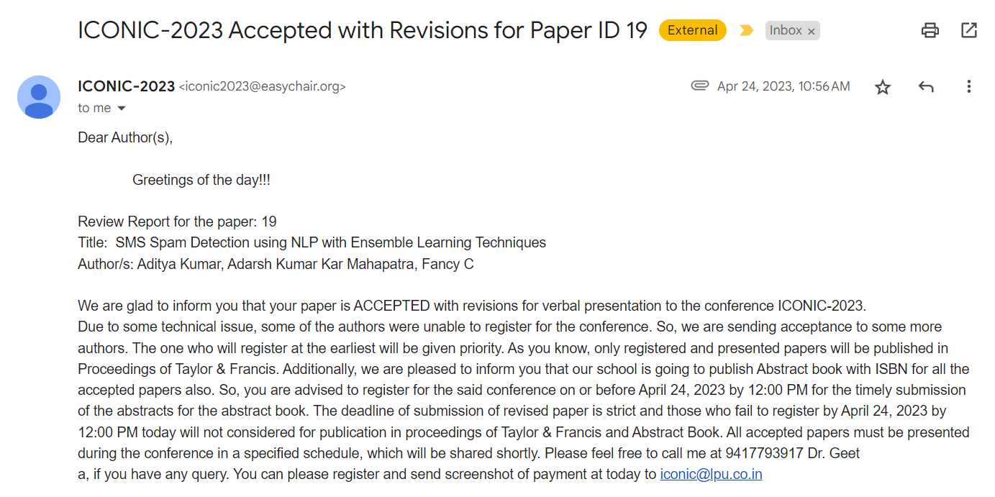
Publication Status
Our Research Paper was accepted in ICONIC ‘23 – International Conference on Networks, Intelligence and Computing

Slide 27
Thank You

